Slide 1
Modeling and Analysis
of Atrial Fibrillation
Radu Grosu
SUNY at Stony Brook
Joint work with
Ezio Bartocci, Flavio Fenton,
Robert Gilmour, James Glimm and Scott A. Smolka

Slide 2
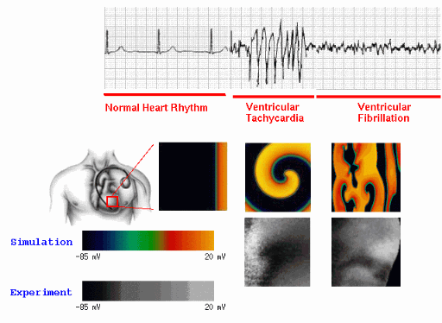
Emergent Behavior in Heart Cells
EKG
Surface
Arrhythmia afflicts more than 3 million Americans alone

Slide 3
Modeling

Slide 4
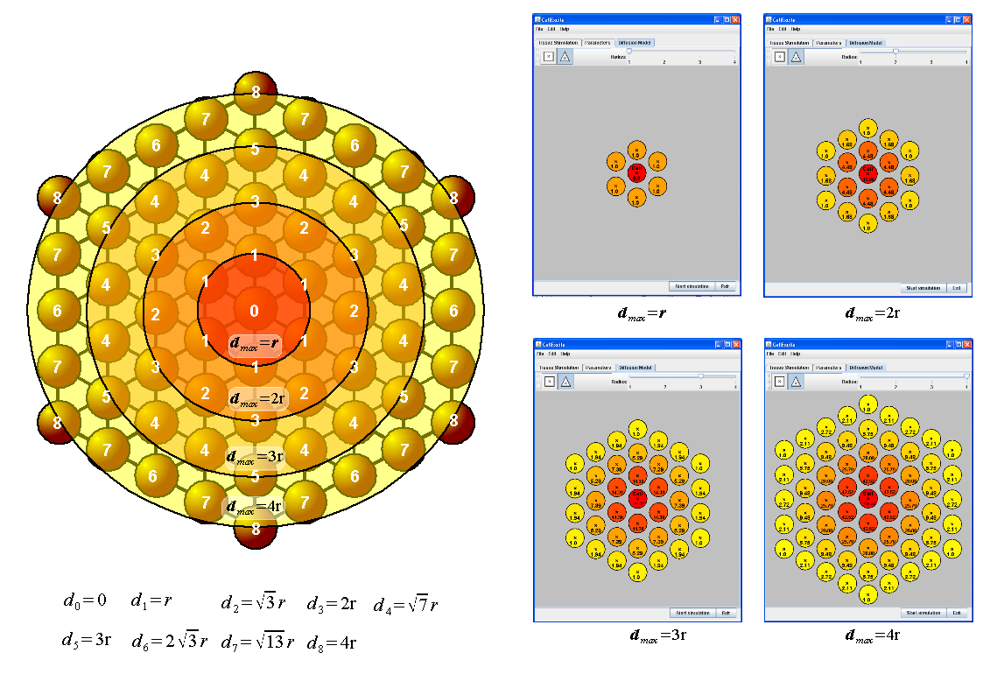
Tissue Modeling: Triangular Lattice
CellExcite and Simulation
Communication by diffusion

Slide 5
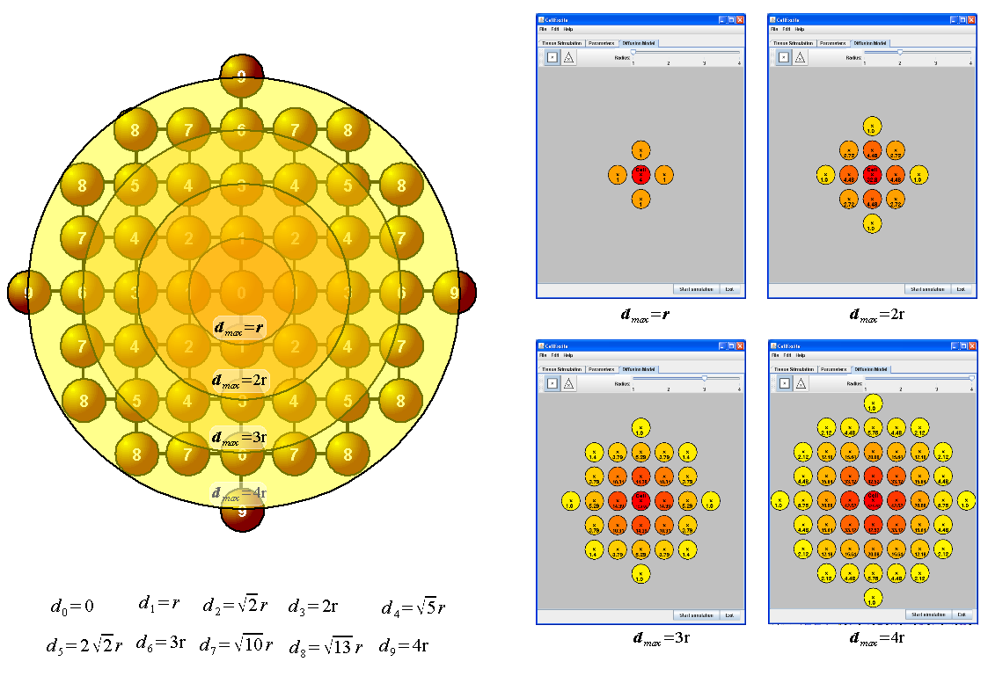
Tissue Modeling: Square Lattice
CellExcite and Simulation
Communication by diffusion

Slide 6
Single Cell Reaction: Action Potential
Membrane’s AP depends on:
Stimulus (voltage or current):
  External / Neighboring cells
Cell’s state
Schematic Action Potential
voltage
AP has nonlinear behavior!
Reaction diffusion system:
Threshold
Stimulus
failed initiation
Resting potential
time
Behavior
In time
Reaction
Diffusion
Notes:
To tell you a little bit more about the nature of the AP produced by the ECs.
When no stimulus is applied the voltage of the cell membrane is @ a level called the resting potential.
When a stimulus arrive, various biochemical processes take place, leading to increase
5 min
Watts, D. J. and S. H. Strogatz. 1998. Collective dynamics of 'small-world' networks. Nature 393:440-42.
In any organ or system, there are 2 kinds of ECs
There are small number of active ECs that are spontaneously excited, such as the pacemaker cells in the heart which produce action potential at a certain frequency.
You can think of these as electrical oscillators.
b) Passive cells, whose behavior is a function of the voltage of its neighboring cells.
In particular, such a cell may or may not fire an AP, and the shape of the AP if it does fire, depends on the ions traveling through its cell membrane, which in turn depends on the state of its neighboring cells.
Explain AP schematic fig.
Under normal conditions, the APs of the cells synchronize and they give rise to stable voltage patters.
Although stability is not clearly defined here, because we are talking about a spatiotemporal voltage pattern over a 2D array of cells.
Intuitively, the spiral wave shown here would be considered a stable voltage pattern.
On the other hand, abnormal behavior corresponds to break-up of these spiral waves..what is called decoherence.
Models for studying arrays of excitable cells.
Cellular automata models:
These systems have been used mainly as testbeds for exploring spatiotemporal chaos and pattern formation in the simplest mathematical settings, rather than as models of real physical systems.
Kuramoto
Exactly solvable… widely used (even has inspired development of synchronization protocols for wireless networks)
Completely disregards topology, or interconnections
Explain equation
Strogatz
In this talk: individual cell models.
It’s a good starting point
Properties of individual cells give us hints about global behavior (pointer to restitution)

Slide 7
Frequency Response
APD90: AP > 10% AP_{m} DI90: AP < 10% AP_{m} BCL: APD + DI

Slide 8
Frequency Response
APD90: AP > 10% AP_{m} DI90: AP < 10% AP_{m} BCL: APD + DI
S1-S2 Protocol: (i) obtain stable S1; (ii) deliver S2 with shorter DI

Slide 9
Frequency Response
APD90: AP > 10% AP_{m} DI90: AP < 10% AP_{m} BCL: APD + DI
S1S2 Protocol: (i) obtain stable S1; (ii) deliver S2 with shorter DI
Restitution curve: plot APD90/DI90 relation for different BCLs

Slide 10
Existing Models
Detailed ionic models:
  Luo and Rudi: 14 variables
  Tusher, Noble² and Panfilov: 17 variables
  Priebe and Beuckelman: 22 variables
  Iyer, Mazhari and Winslow: 67 variables
Approximate models:
  Cornell: 3 or 4 variables
  SUNYSB: 2 or 3 variable

Slide 11
Stony Brook’s Cycle-Linear Model

Slide 12
Objectives
Learn a minimal mode-linear HA model:
  This should facilitate analysis
Learn the model directly from data:
  Empirical rather than rational approach
Use a well established model as the “myocyte”:
  Luo-Rudi II dynamic cardiac model

Slide 13
HA Identification for the Luo-Rudi Model
(with P. Ye, E. Entcheva and S. Mitra)
Training set: for simplicity 25 APs generated from the LRd
  BCL₁ + DI₂: from 160ms to 400 ms in 10ms intervals
Stimulus: step with amplitude -80μA/cm², duration 0.6ms
Error margin: within ±2mV of the Luo-Rudi model
Test set: 25 APs from 165ms to 405ms in 10ms intervals

Slide 14
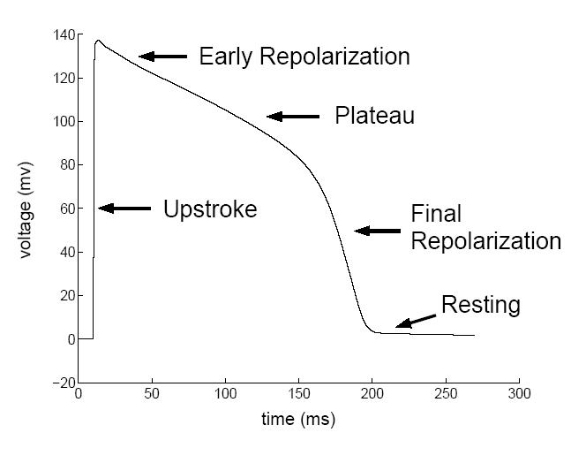
Action Potential (AP) Phases
Stimulated

Slide 15
Identifying a Mode-Linear HA for One AP
Stimulated

Slide 16
Identifying the Switching for one AP
Null Pts: discrete 1st Order deriv.
Infl. Pts: discrete 2nd Order deriv.
Thresholds: Null Pts and Infl. Pts
Segments: Between Seg. Pts
Problem: too many Infl. Pts
Problem: too many segments?

Slide 17
Identifying the Switching for one AP
Null Pts: discrete 1st Order deriv.
Infl. Pts: discrete 2nd Order deriv.
Thresholds: Null Pts and Infl. Pts
Segments: Between Seg. Pts
Problem: too many Infl. Pts
Problem: too many segments?
Solution: use a low-pass filter
  Moving average and spline LPF: not satisfactory
  Designed our own: remove pts within trains of inflection points

Slide 18
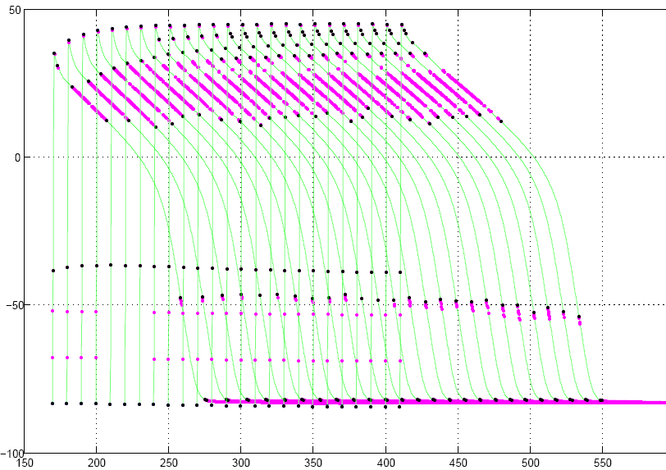
Identifying the Switching for all AP
Problem: somewhat different inflection points

Slide 19
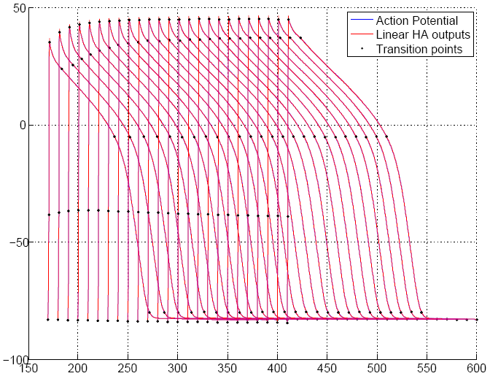
Identifying the Switching for all AP
Solution: align, move up/down and remove inflection points
  - Confirmed by higher resolution samples

Slide 20
Identifying the HA Dynamics for One AP
Modified Prony Method
Stimulated

Slide 21
Summarizing all HA
Stimulated

Slide 22
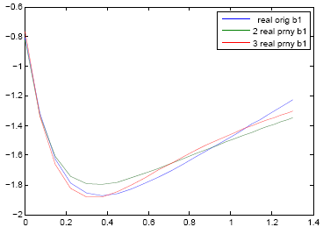
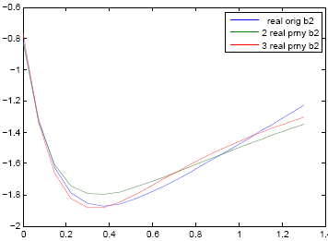
Finding Parameter Dependence on DI
Solution: apply mProny once again on each of the 25 points

Slide 23
Summarizing all HA
Cycle Linear
Stimulated

Slide 24
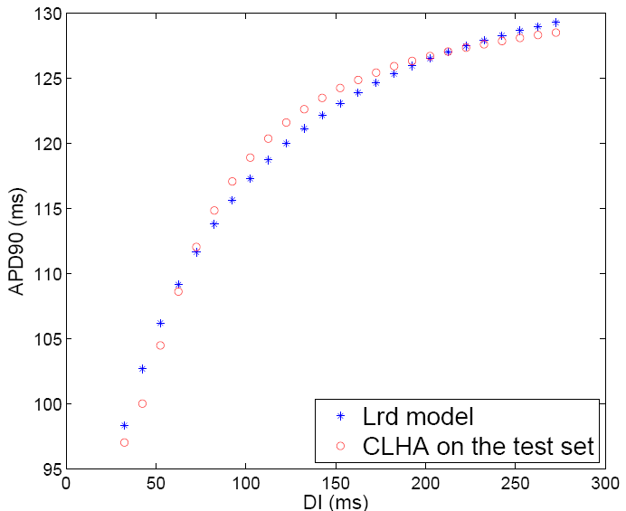
Frequency Response on Test Set
AP on test set: still within the accepted error margin
Restitution on test set: follows very well the nonlinear trend

Slide 25
Cornell’s Nonlinear Minimal Model

Slide 26
Objectives
Learn a minimal nonlinear model:
  This should facilitate analysis
Approximate the detailed ionic models:
  Rational rather than empirical approach
Identify the parameters based on:
  Data generated by a detailed ionic model
  Experimental, in-vivo data

Slide 27
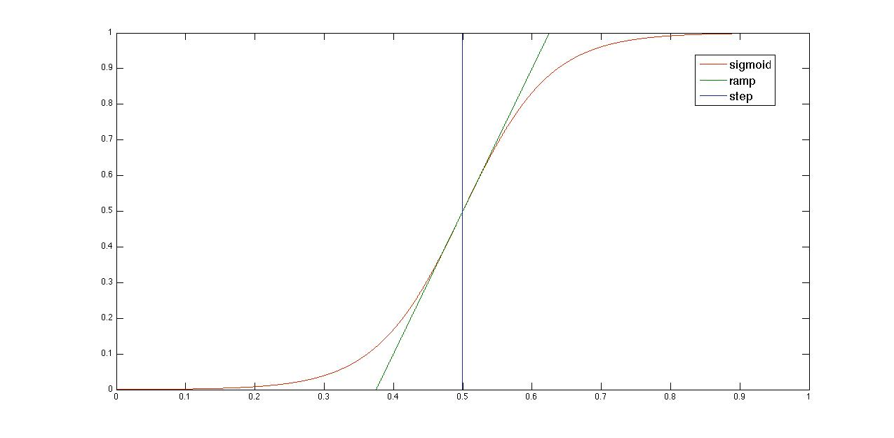
Switching Control

Slide 28
Cornell’s Minimal Model
voltage
Diffusion
Laplacian
Fast input
current
Slow input
current
Slow output
current

Slide 29
Cornell’s Minimal Model
Heaviside
(step)
Activation
Threshold
Fast input
Gate
Slow Input
Gate
Slow Output
Gate
Piecewise
Nonlinear
Resistance
Time Cst
Piecewise
Bilinear
Piecewise
Nonlinear
Piecewise
Linear
Sigmoid
(s-step)
Nonlinear

Slide 30
Time Constants and Infinity Values
Piecewise
Constant
Sigmoidal
Piecewise
Linear

Slide 31
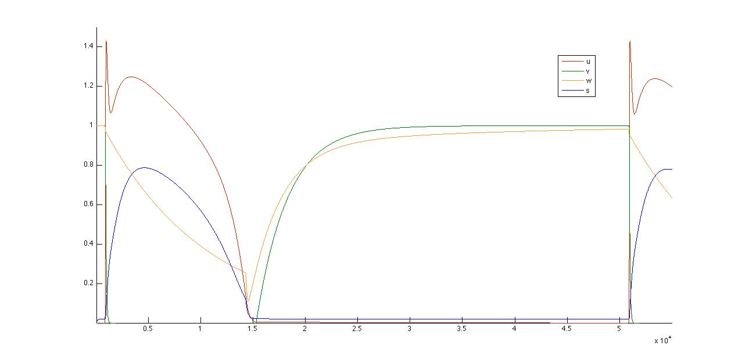
Single Cell Action Potential

Slide 32
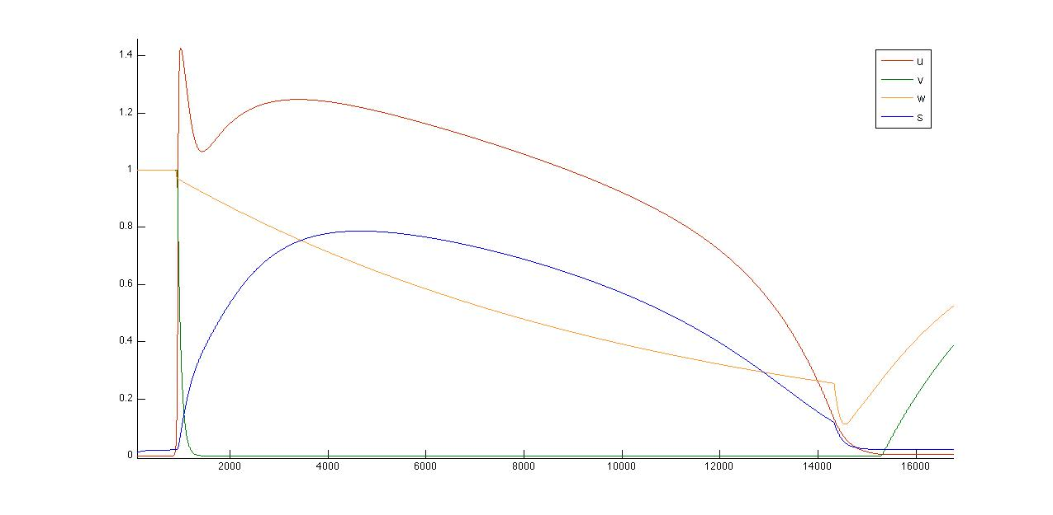
Cornell’s Minimal Model

Slide 33
Partition with Respect to v

Slide 34
Partition with Respect to v

Slide 35
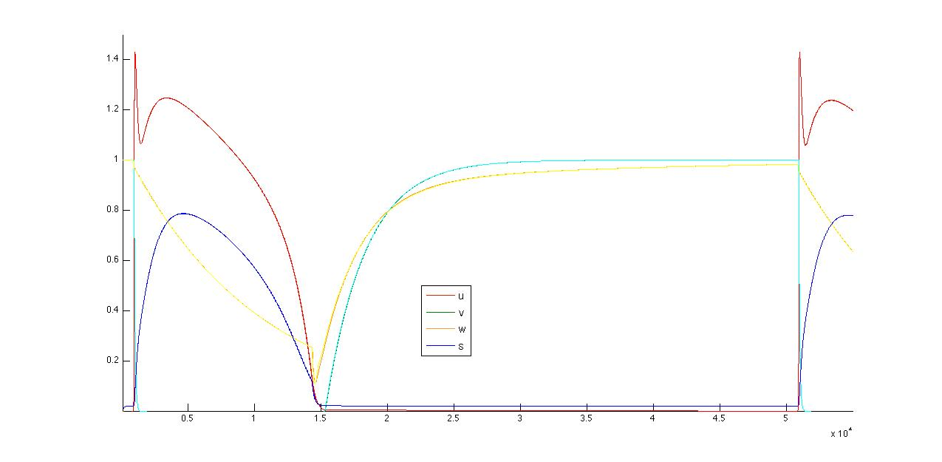
Superposed Action Potentials

Slide 36
HA for the Model

Slide 37
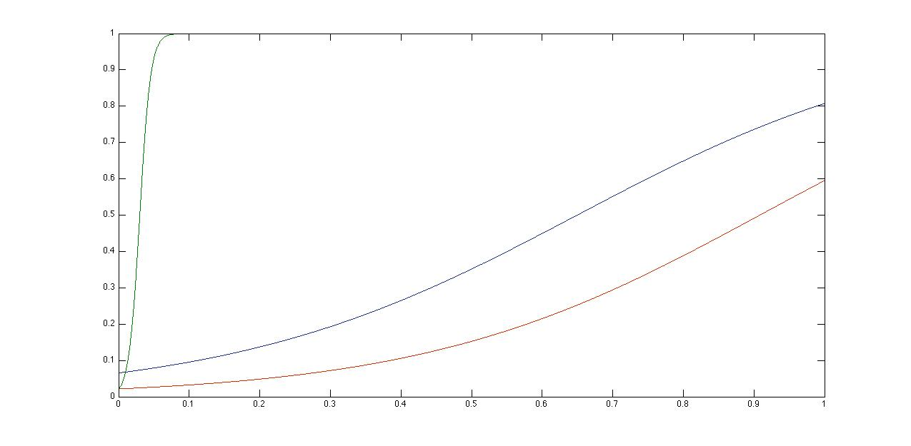
Analysis of Sigmoidal Switching

Slide 38
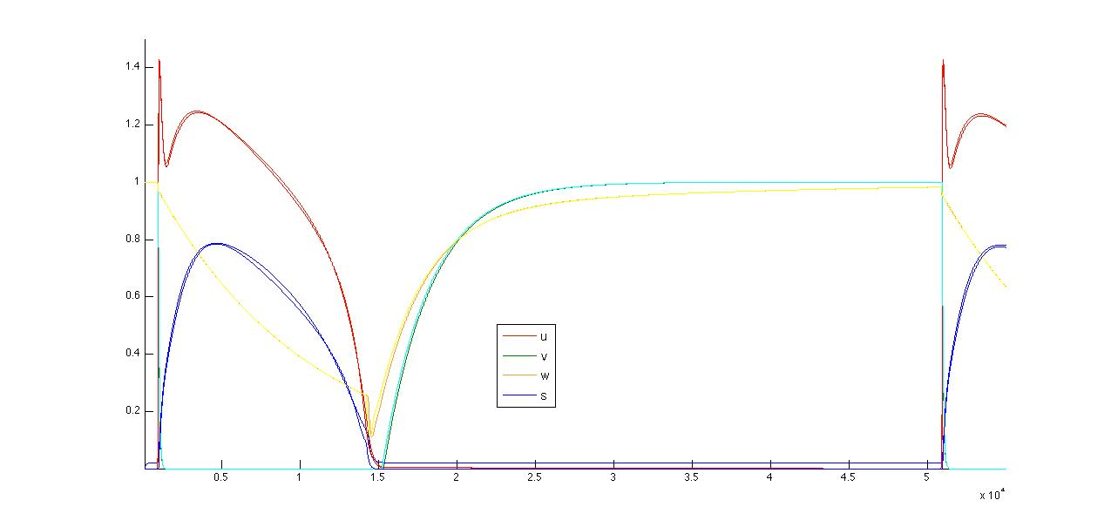
Superposed Action Potentials

Slide 39
Current HA of Cornell’s Model

Slide 40
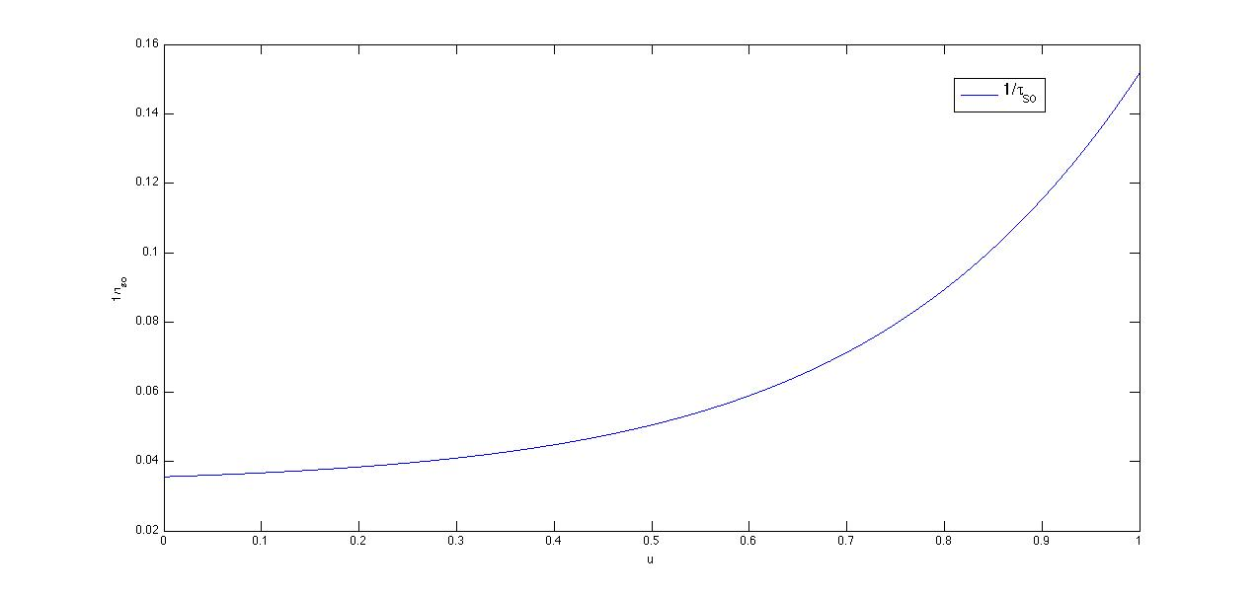
Analysis of 1/τ_{so} ?

Slide 41
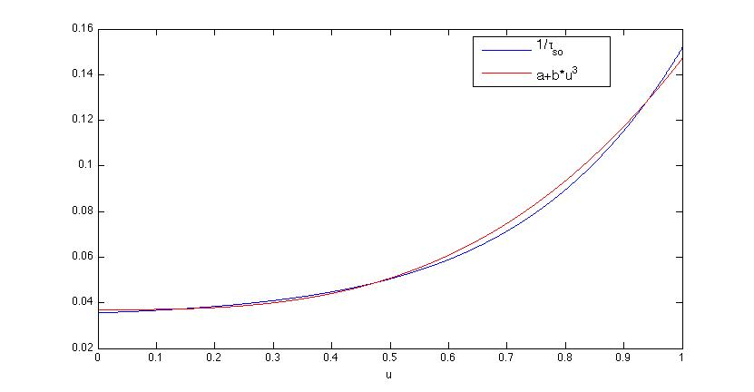
Cubic Approximation of 1/τ_{so} ?

Slide 42
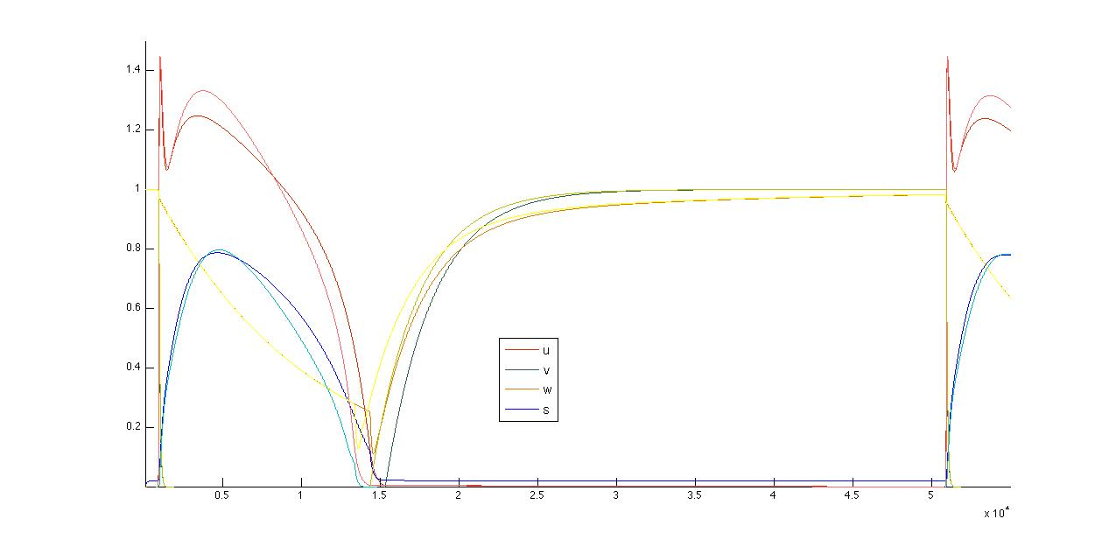
Superposed Action Potentials
Very sensitive!

Slide 43
Summary of Models
Both models are nonlinear
  Stony Brook’s: Linear in each cycle
  Cornell’s: Nonlinear in specific modes
Both models are deterministic
Both models require identification
  Stony Brook’s: On a mode-linear basis
  Cornell’s: On an adiabatically approximated model

Slide 44
Modeling Challenges
Identification of atrial models
  Preliminary work: Already started at Cornell
Dealing with nonlinearity
  Analysis: New nonlinear techniques? Linear approx?
Parameter mapping to physiological entities
  Diagnosis and therapy: To be done later on

Slide 45
Analysis

Slide 46


Atrial Fibrillation (Afib)
A spatial-temporal property
  Has duration: it has to last for at least 8s
  Has space: it is chaotic spiral breakup
Formally capturing Afib
  Multidisciplinary: CAV, Computer Vision, Fluid Dynamics
  Techniques: Scale space, curvature, curl, entropy, logic

Slide 47
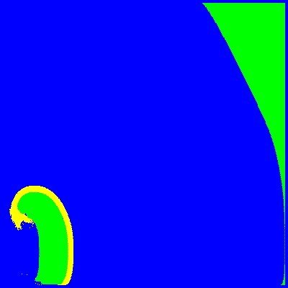
Spatial Superposition
Detection problem:
  Does a simulated tissue contain a spiral ?
Specification problem:
  Encode above property as a logical formula?
  Can we learn the formula?
How? Use Spatial Abstraction

Slide 48
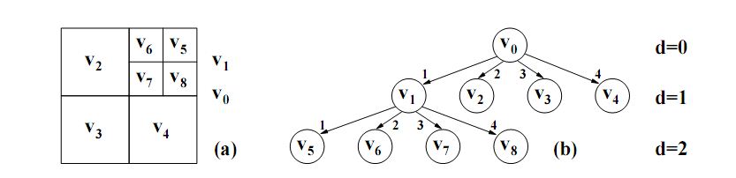
Superposition Quadtrees (SQTs)
Abstract position and compute PMF p(m) ≡ P[D=m]

Slide 49
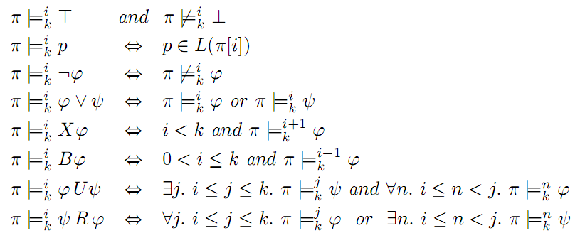
Linear Spatial-Superposition Logic
Syntax
Semantics

Slide 50
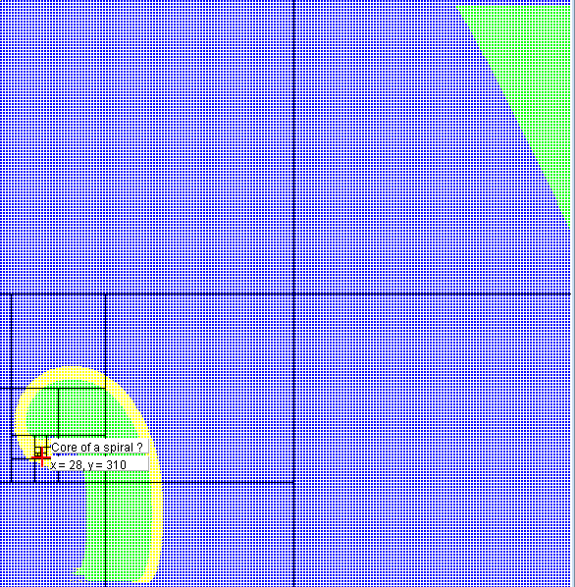
The Path to the Core of a Spiral
Root
1
2
3
4
1
2
3
4
1
2
3
4
1
2
3
4
Click the core to
determine the quadtree
1
2
3
4

Slide 51
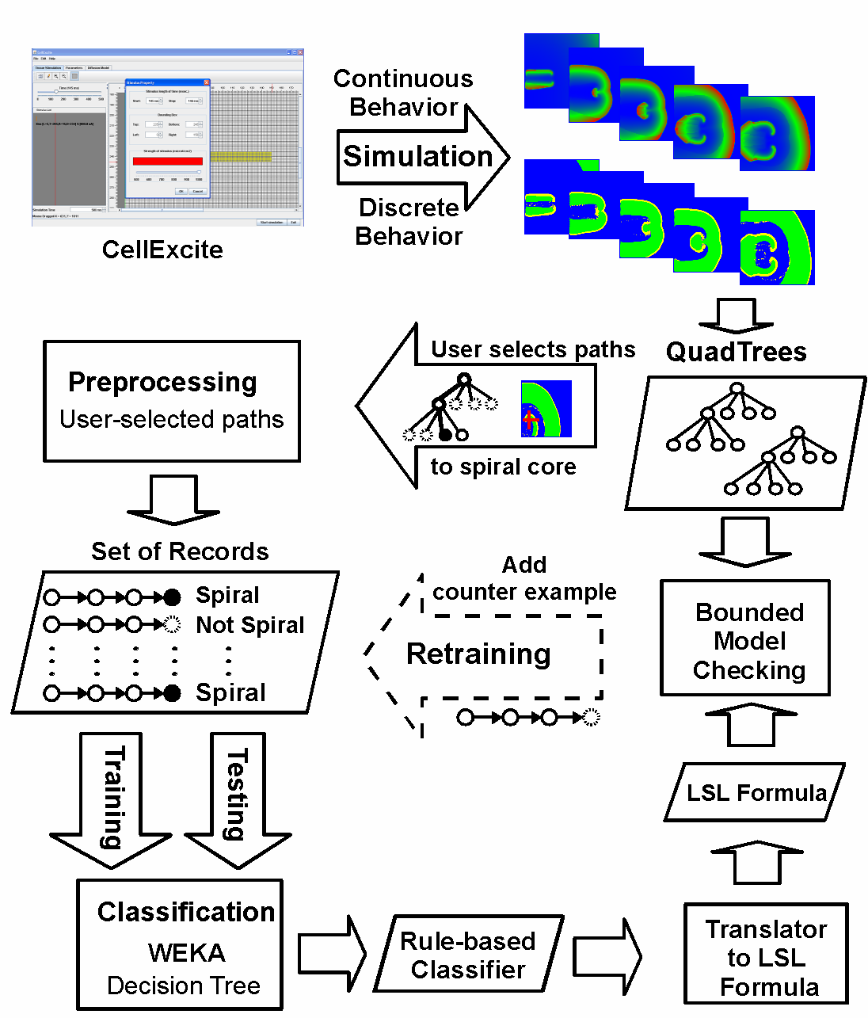
Overview of Our Approach

Slide 52
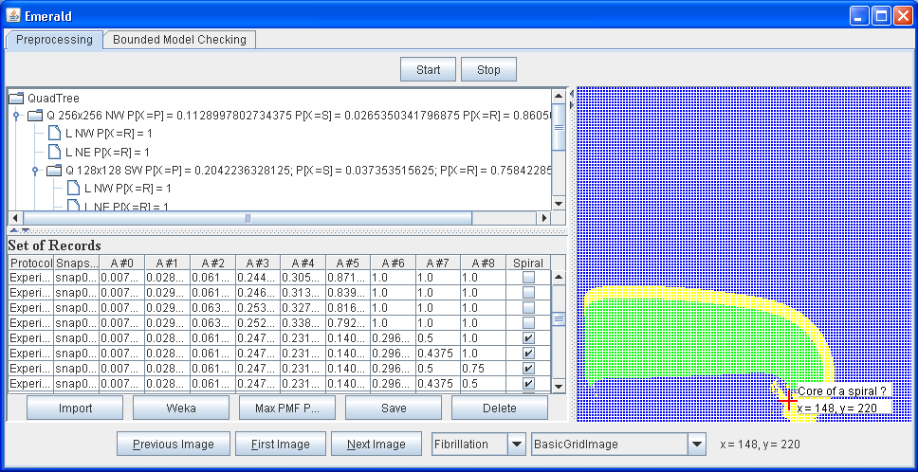
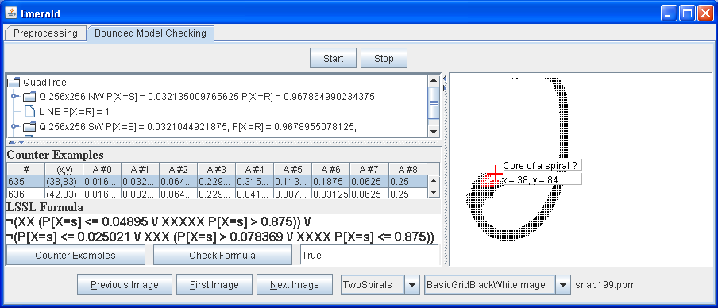
Emerald: Learning LSSL Formula
Emerald: Bounded Model Checking

Slide 53
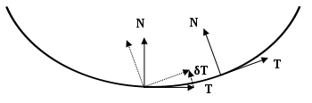
Curvature Analysis
N
N
T
T
Some properties of the curvature:
  The curvature of a straight line is identical to 0
  The curvature of a circle of radius R is constant
  Where the curve undergoes a tight turn, the curvature is large
Measuring the curvature:
  Adapting Frontier Tool [Glimm et.al]: MPI code on Blue Gene
  Also corrects topological errors

Slide 54
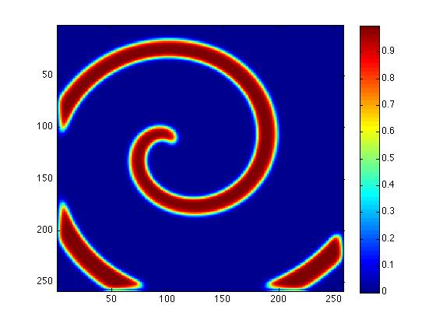
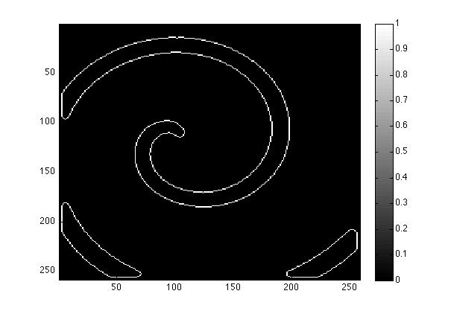
Edge Detection
Scalar field
Front wave
Canny algorithm

Slide 55
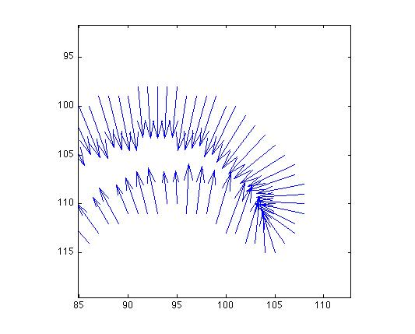
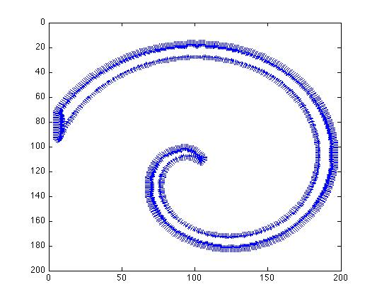
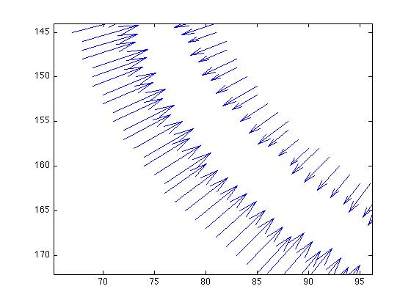
Normal Vectors Computation
Compute the Gradient

Slide 56
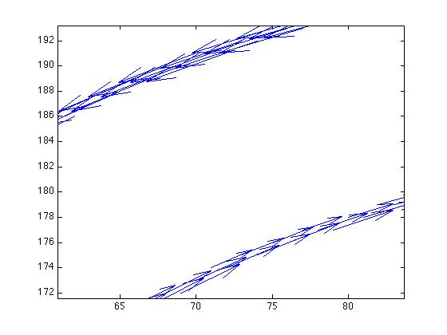
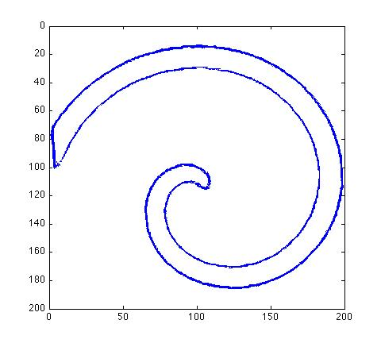
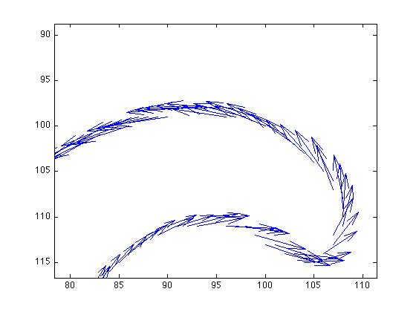
Tangent Vectors Computation
Based on the Gradient

Slide 57
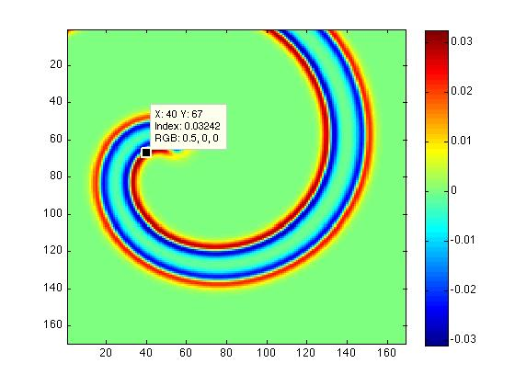
The Curl of the Tangent Field
Curl = infinitesimal rotation of a vector field (circulation density of a fluid)

Slide 58
Verification Setup
Models are deterministic with one initial state:
  A spiral: induced with a specific protocol
Verification becomes parameter estimation/synthesis:
  In normal tissue: no fibrillation possible
  Diseased tissue: brute force gives parameter bounds
  Parameter space search: increases accuracy
Parameters are mapped to the ionic entities:
  Obtained mapping: used for diagnosis and therapy

Slide 59
Possible Collaborations
Pancreatic cancer group:
  Spatial properties: also a reaction diffusion system
  Nonlinear models: approximation, diff. invariants, statistical MC
  Parameter estimation: information theory, statistical MC
Aerospace / Automotive groups:
  Monitoring & Control: low energy defibrillation, stochastic HA
  Machine learning: of spatial temporal patterns

